Slide 1
Personal Diet Problem Solver with Cost Optimization
Group members:
Aakanksha Gokhe
Kashmira Pardeshi

Slide 2
Contents
Understanding the Problem
Background
Current Approach
Why is it important?
Who Cares?
Our Approach
Implementation
Demonstration
Conclusion
Questions

Slide 3



THE PROBLEM
$150 - $180 Expense / Week

Slide 4


BACKGROUND & FACTS

Slide 5














WHY IS IT IMPORTANT?

Slide 6





OUR APPROACH
LINEAR PROGRAMMING MODEL MINIMIZE THE COST OF MEAL PER DAY
ENSURING, ESSENTIAL SET OF DAILY NUTRIENTS ARE CONSUMED
FINALLY, REDUCING THE OVERALL EXPENDITURE ON FOOD
DATA SOURCES:
1. Minimum calorie requirement
2. Nutritional fact and cost

Slide 7
IMPLEMENTATION
Variables used:
f₁, f₂, …, f_{n} Food Items
qty₁, qty₂, …, qty_{n} Quantity of Food Items
c₁, c₂, …, c_{n} Cost of Food Items
cal₁, cal₂, …, cal_{n} Calorie of Food Items
carb₁, carb₂, …, carb_{n} Carbohydrate content of Food Items
fat₁, fat₂, …, fat_{n} Fat content of Food Items
pro₁, pro₂, …, pro_{n} Protein content of Food Items

Slide 8
IMPLEMENTATION
OBJECTIVE FUNCTION:
Min C( Food Items quantity, Cost) = c₁ * qty₁ + c₂ * qty₂ + … + c_{n}*qty_{n}
CONSTRAINTS:
cal₁+ cal₂ + … + cal_{n} >= minimum requirement of calorie
45g >= carb₁ + carb₂ + … +carb_{n} <= 60g
44g >= fat₁ + fat₂ + … + fat_{n} <= 78g
pro₁ + pro₂ + … + pro_{n} >= 0.37 * body weight

Slide 9



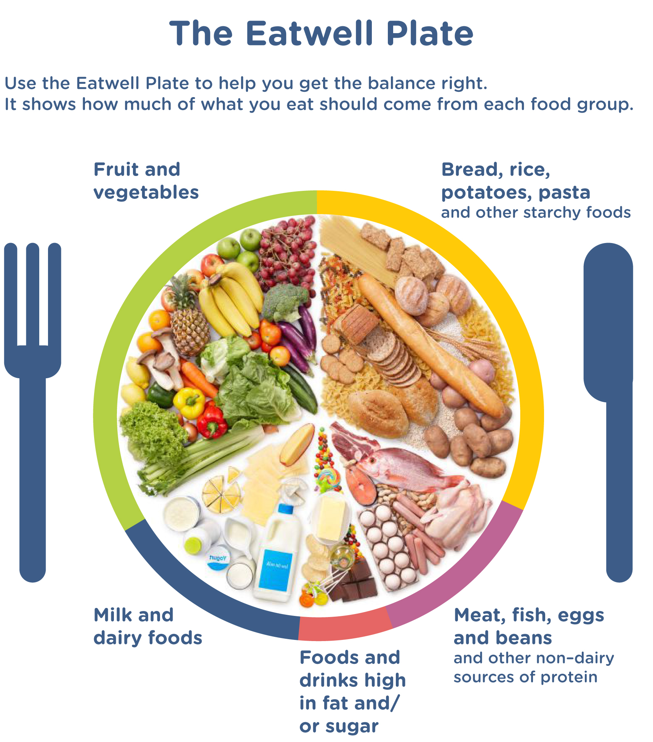





APPLICATION
INPUT
OUTPUT
Optimized cost and quantity of food items for each meal per day

Slide 10
PuLP LIBRARY
1. Import ‘pulp’ library
2. Declare all the variables using ‘pulp.LPVariable()’ function
3. Mention the functionality – In this case Minimization
4. Define objective function
5. Define constraints
6. Solve the linear equations using ‘.solve()’ function

Slide 11
DEMONSTRATION

Slide 12
CONCLUSION
Cost is optimized SUGGESTION:
Essential nutrients are consumed It is always recommended that you
You are healthy and fit combine healthy eating with exercise!

Slide 13
REFERENCE
https://health.gov/dietaryguidelines/2015/guidelines/appendix-2/#femalesd
https://health.gov/dietaryguidelines/2015/guidelines/appendix-2/#males
https://neos-guide.org/content/diet-problem
https://data.world/adamhelsinger/food-nutrition-information
https://pythonhosted.org/PuLP/

Slide 14
Thank You

